Slide 1
OBSTETRICAL ANAL SPHINCTER INJURY Dr Sunita Samal, MD (O&G) Associate Professor MGMC & RI, PUDUCHERRY

Slide 2
Introduction
Obstetric trauma
Fecal Incontine
-nce
Sexual dysfunction
Perineal pain
Urgency & soiling
Notes:
70-80 %of women develop some degree of perineal trauma overt or occult. 60-70% need suturing. 91% of womenreport atleast one new persistant symptoms 8wk after delivery. Most of symptoms arise when anal sphincter is involved

Slide 3
The reported incidence of obstetric anal sphincter injury is 1-6% of all vaginal deliveries
0.4-2.5% with mediolateral episiotomy but upto 19% with midline episiotomy
Failure to recognise sphincter injury at the time of delivery.
Increase in medicolegal cases associated with ASI

Slide 4
ANATOMY & PHYSIOLOGY

Slide 6
Function of anal sphincter
A structural and functionally intact anal sphincter complex maintain continence.
IAS contributes 70-85% of resting anal sphincter pressure & responsible for maintaining anal continence at rest.
EAS is responsible for majority of squeeze tone & protects against fecal leakage during rise in intra-abdominal pressure
Recto-anal inhibitory reflex

Slide 7
Classification of perineal injuries
Perineal injury
I degree:
Perineal skin
II degree :
Perineal muscle
III degree : inv EAS +IAS
IV degree ASI+ rectal mucosa
< 50% EAS torn
> 50% EAS torn
IAS torn

Slide 8
Obstetric anal sphincter injury
Third degree perineal tear
Fourth degree perineal tear

Slide 9
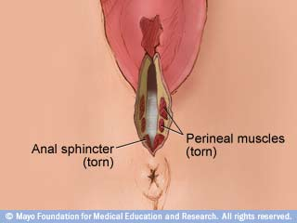
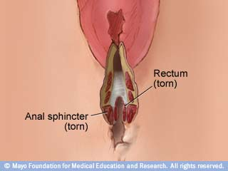
THIRD DEGREE PERINEAL TEAR
FOURTH-DEGREE
PERINEAL TEAR

Slide 10
Effect of vaginal delivery
Disruption of anorectal function by direct muscle trauma or injury to nerve supplying anorectal complex
Fecal urgency develops when EAS is involved
If both EAS & IAS fecal leakage can occur at rest

Slide 11
Anal incontinence: Any involuntary loss of feaces , flatus or urge incontinence ,that is adversly affecting a woman’s quality of life
About 50% of women develop anorectal complaint despite appearantly adequate repair
85% of women have persistant sphincter defect
Prevalence of these symptoms often under-reported

Slide 12
Assessment of risk factor is essential
to allow primary prevention

Slide 13
Birth weight over 4 kg(2%)
Persistent occipitoposterior position(3%)
Nulliparity(4%)
Induction of labour(2%)
Epidural analgesia(2%)
Second stage longer than 1 hour(4%)
Shoulder dystocia (4%)
Midline episiotomy(3%)
All assisted vaginal delivery(7%)
Uterine fundal expression

Slide 14
Diagnosis
A systematic examination is mandatory after delivery, especially following instruments,
- under adequate anaesthesia & light
- by experienced staff
Anal manometry
PNTML (Pudendal nerve terminal motor latency)
Anal endosonography- limited availability & poorly trained staff
MRI with endorectal coil

Slide 15
Anal endosonography
Routinely used in investigation of fecal incontinence
High resolution 360 image from within the anal sphincter
Specialised ultrasound probe inserted to anal canal

Slide 16
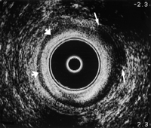
NORMAL VIEW
DEFECT IN EAS

Slide 17
35% of women reported ASI by endosonography after their first delivery (sultan et al)
Reduction of fecal incontinence symptoms at 12month who had surgical repair of ASI diagnosed by endosonography (faltin et al)
Anal-endosonography is more useful than anal manometry

Slide 18
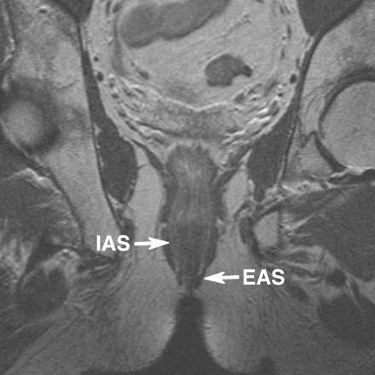
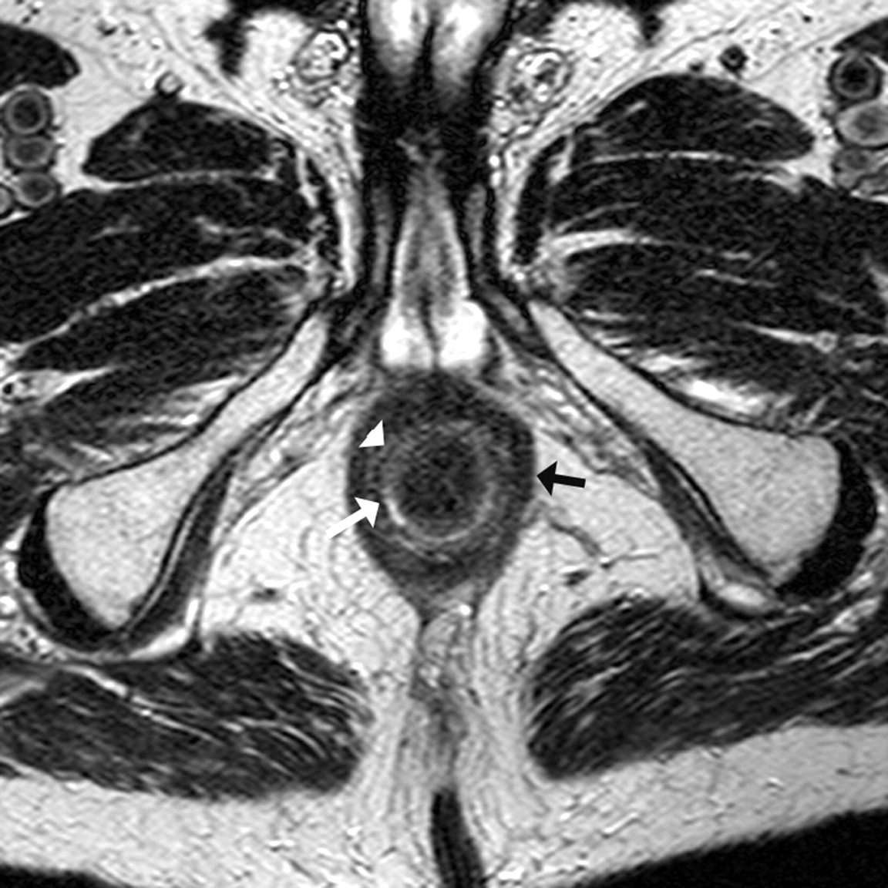
MRI
CORONAL VIEW
TRANSVERSE VIEW

Slide 19
Technique & method of repair of ASI
Repair should take place in operation theatre
Adequate light
Regional or general anaesthesia
Anal mucosa & IAS should be repaired before EAS

Slide 20
Cont.
Suture material- PDS or vicryl (3-0) both are recommended for sphincter repair
RCT showed no difference in both suture material in terms of anal incontinence , perineal pain or suture migration.
Burying of surgical knot beneath the superficial perineal muscles to prevent knot migration
Repair should be done by appropriately trained obstetrician

Slide 21
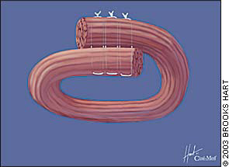
End-to-end (approximation) method
Overlap method

Slide 22
Postoperative management
Broad spectrum antibiotic with metronidazole
Use of postoperative laxatives to reduce the incidence of wound dehiscence
All women should be offered postoperative physiotherapy and pelvic exercises for 6-12wks following repair

Slide 23
Follow-up after ASI
Women should be followed up at 6wks postpartum
Use of validated fecal incontinence questionnaire
Symptomatic women should be sent to colorectal surgeon
Persistent sphincter defect may require secondary repair

Slide 24
Outcome of primary repair
Prognosis is good with 60-80% asymptomatic at
12months
Evaluation by endoanal ultrasound & neurophysiological
tests
Poor outcome related to persistent sphincter defect
Anal incontinence 40% with traditional end to end
repair & persistent sphincter defect by EAUS 54-88%
Improved outcome with overlap technique (sultan et al 1999)
Further RCT showed both technique with similar
outcome & most common symptom is incontinence to
flatus

Slide 25
Future pregnancy and mode of delivery
RCOG recommends
Counseling regarding the risk of developing anal incontinence or worsening symptoms with subsequent vaginal delivery
Women who are symptomatic or who have abnormal endo-anal ultrasound or manometry , should be offered the option of elective caesarean section

Slide 26
Prediction & prevention of ASI
Obstetricians should be aware of the risk factors
Routine episiotomy is not recommended
Where episiotomy is indicated, mediolateral technique is preferred with attention to the angle cut away from midline
Low risk of injury with wide angled episiotomy
Elective caesarean section is protective whereas caesarean late in 1st stage or 2nd stage does not protect anal sphincter

Slide 27
Take Home Message
Obstetric anal sphincter injury is the leading cause of fecal incontinence
Routine episiotomy is not recommended
Perineal injury should be inspected properly especially after traumatic vaginal delivery
Trained obstetrician should undertake repair in theatre using standard intra & postoperative protocol
Formal training in anal sphincter repair technique, is recommended as an essential component of obstetric training

Slide 28
Contd.
Outcome of overlap & end-to-end technique are equivalent
Women should be counseled about the future risk of incontinence
Symptomatic women should be offered delivery by elective caesarean section
No evidence to guide the management of asymptomatic women

